Slide 1


Slide 2


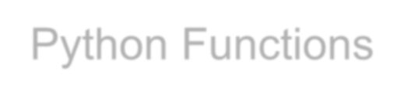





Python Functions
Define functions
Passing arguments to Function
Return a value from function
Scope of Objects
Default arguments
Positional and keyword arguments
Variable length arguments

Slide 3

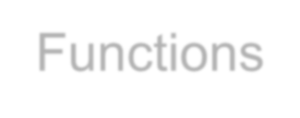
Functions
Piece of reusable code
Solves particular task
Call function instead of writing code yourself

Slide 4

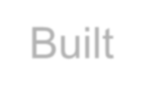

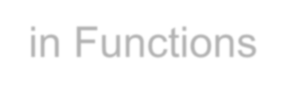
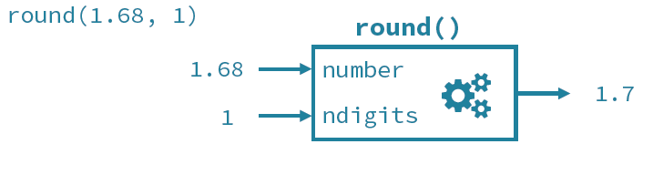
Built-in Functions

Slide 5

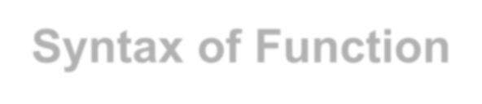

Syntax of Function

Slide 6

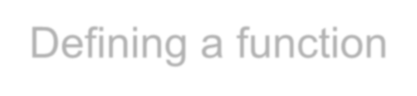

Defining a function

Slide 7


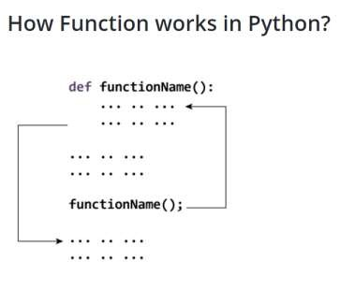
Function Call
Once we have defined a function, we can call it from another function, program or even the Python prompt.
To call a function we simply type the function name with appropriate paramete
Calling the Function my_function()
rs.

Slide 8
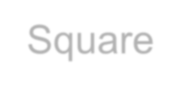
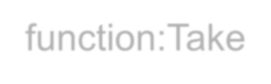

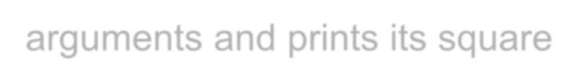
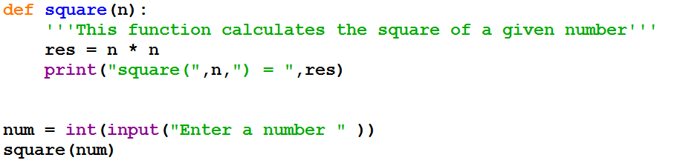
Square function:Take one arguments and prints its square

Slide 9

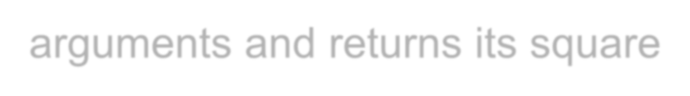
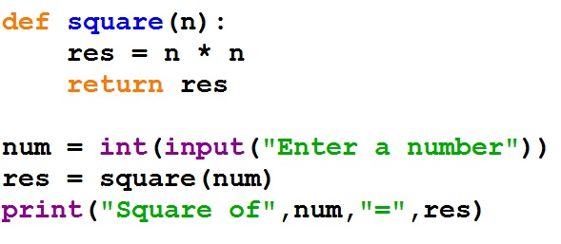
Square function:Take one arguments and returns its square

Slide 10


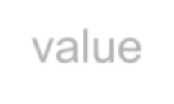
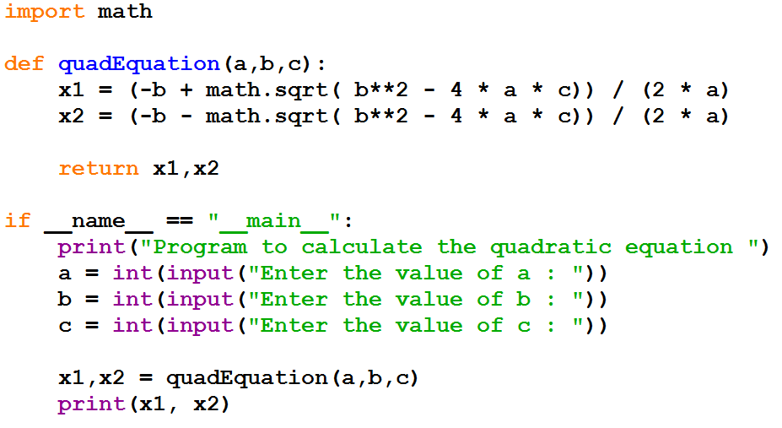
Function returning multiple value

Slide 11


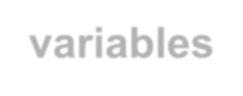
Scope and Lifetime of variables
Scope of a variable is the portion of a program where the variable is recognized.
Parameters and variables defined inside a function is not visible
from outside. Hence, they have a local scope.
Lifetime of a variable is the period throughout which the variable exits in the memory. The lifetime of variables inside a function is as long as the function executes.
They are destroyed once we return from the function. Hence, a function does not remember the value of a variable from its previous calls.

Slide 12


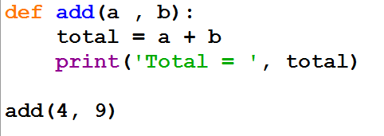

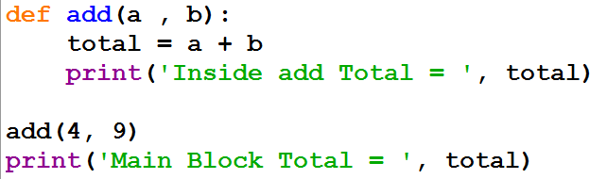

Slide 13

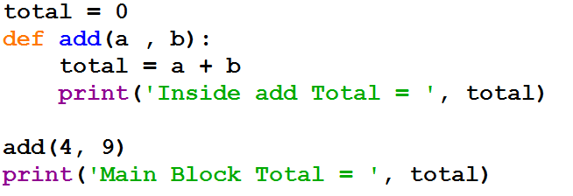

Slide 14
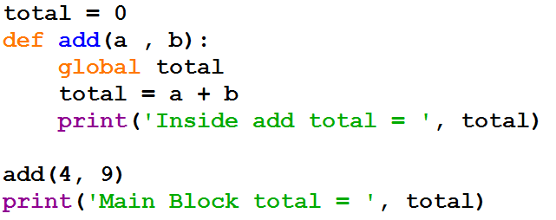

Slide 15
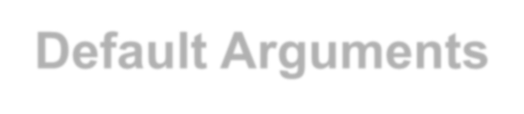
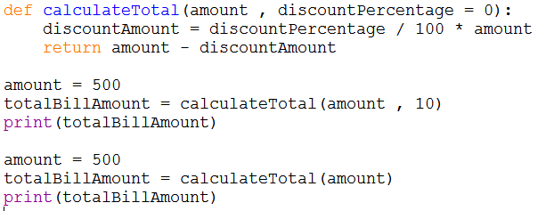
Default Arguments
Function arguments can have default values in Python.
We can provide a default value to an argument by using the assignment operator (=).

Slide 16

Default Arguments
In this function, the
parameter amount does not have a default value and is required (mandatory) during a call.
On the other hand, the parameter discountPercentage has a default value of 0. So, it is optional during a call.
If a value is provided, it will overwrite the default value.
Any number of arguments in a function can have a default value.

Slide 17

Default Arguments
Once we have a default argument, all the arguments to its right must also have default values.
SyntaxError: non-default argument follows default argument

Slide 18

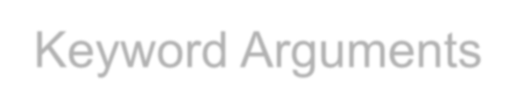
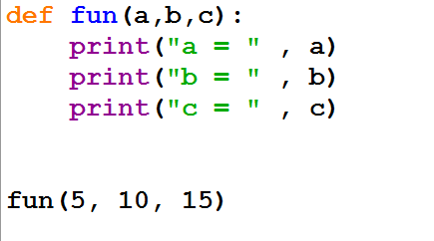

Keyword Arguments

Slide 19


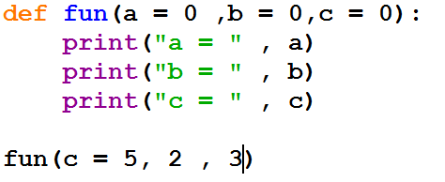
Positional argument cannot follow keyword argument

Slide 20

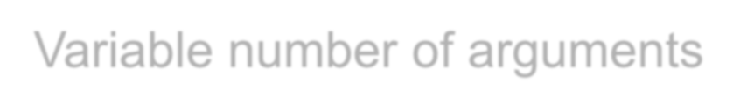

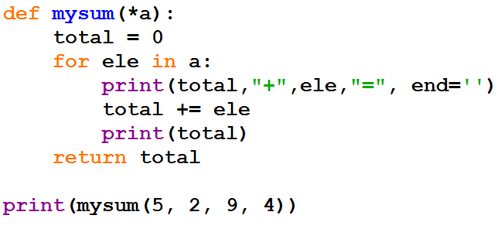

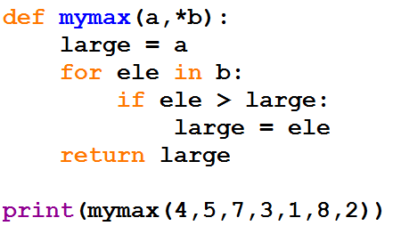
Variable number of arguments

Slide 21

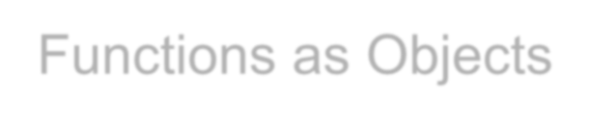
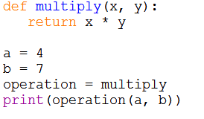
Functions as Objects
Although functions are created differently from normal variables, functions are just like any other kind of value.
They can be assigned and reassigned to variables, and later referenced by those names.

Slide 22



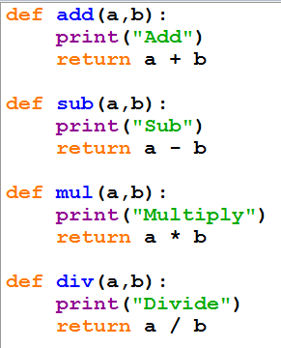
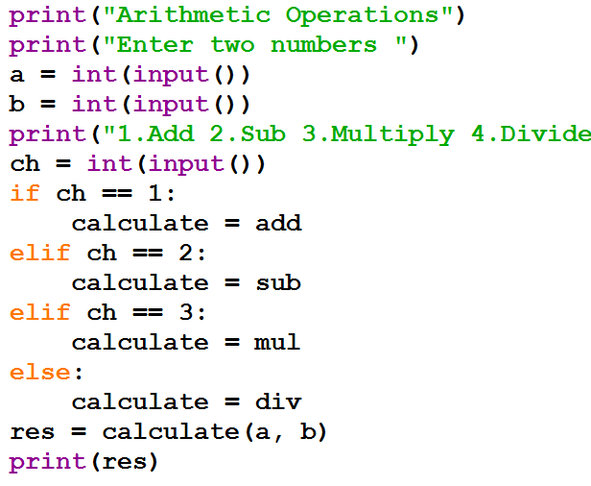

Slide 23


